Slide 1
Project Report
Analyzing Amazon Sales Data & Fifa World Cup Analysis

Slide 2

Project Report
Analyzing Amazon Sales Data

Slide 3
Introduction
Brief Overview of the Project:
The "Analyzing Amazon Sales Data" project aims to explore and understand the sales performance on Amazon over a specified period. By analyzing a dataset containing sales transactions, this project seeks to uncover trends, patterns, and insights that can help in making informed business decisions. The key objectives include identifying top-selling products, understanding seasonal sales trends, and analyzing customer purchasing behavior to recommend strategies for improving sales performance.
Objectives of the Analysis
Identify Top-Selling Products: Determine which products generate the highest sales and revenue.
Analyze Sales Trends: Investigate monthly, seasonal, and yearly sales trends to understand peak periods.
Understand Customer Behavior: Examine purchasing patterns, including repeat purchases and preferences across different categories.
Segment Analysis: Identify the performance of different product categories and segments.
Revenue and Profit Analysis: Evaluate the revenue and profit margins across various products and categories.
Develop Sales Strategies: Provide data-driven recommendations to improve sales performance and enhance marketing strategies.

Slide 4
Amazon Sales Data Overview
Data Source:
The data used for this analysis was sourced from Amazon’s sales transaction records. The dataset includes comprehensive details of sales transaction, covering various aspects such as region, country, item type, units sold, price, cost, total revenue etc.
Period Covered:
The dataset encompasses sales data over a period of seven years, from 2010 to 2017. This period was chosen to provide a robust timeframe for identifying long-term trends, seasonal patterns, and significant changes in sales performance.

Slide 5
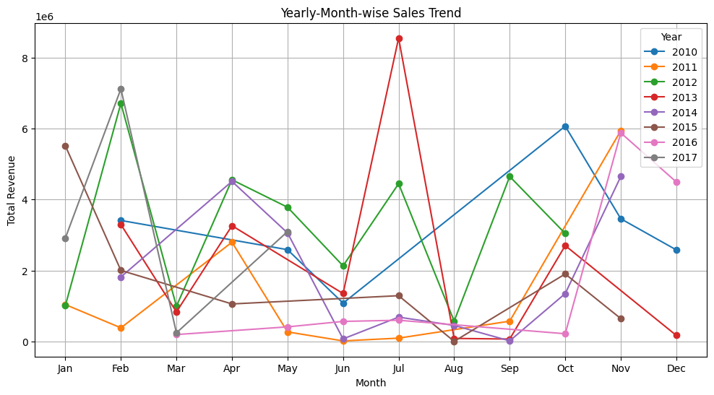
Amazon Sales Data: EDA
Yearly-Month-Wise Sales Trend

Slide 6
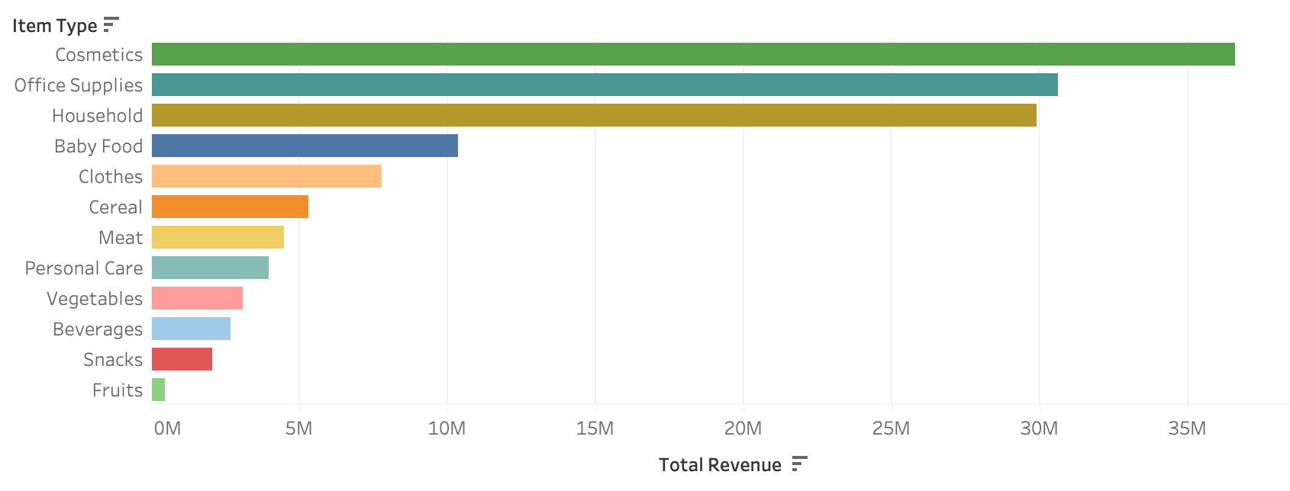
Amazon Sales Data: EDA
Top Products by Revenue

Slide 7
Amazon Sales Data: Recommendations
Optimize Inventory Management:
Insight: Certain products consistently show high sales volumes, while others have sporadic or low sales.
Recommendation: Focus on maintaining higher inventory levels for top-selling products and consider reducing or reevaluating the stock of lower-performing items to optimize warehouse space and reduce holding costs.
Enhance Marketing Strategies:
Insight: Sales trends indicate peak periods during certain months (typically around June or July).
Recommendation: Increase marketing efforts and promotional activities during peak periods to maximize sales. Implement targeted campaigns using historical sales data to predict and capitalize on high-demand times.

Slide 8
Amazon Sales Data: Recommendations
Expand Popular Categories:
Insight: Certain product categories consistently outperform others in terms of sales and customer interest.
Recommendation: Consider expanding the range of products within popular categories. Introduce new, related products that align with customer interests and buying patterns.
Analyse and Address Sales Decline:
Insight: Some products or categories may show a decline in sales over time.
Recommendation: Conduct further analysis to understand the reasons behind declining sales. Implement corrective measures such as price adjustments, product improvements, or targeted promotions to revive interest.

Slide 9
Amazon Sales Data: Conclusion
The analysis of Amazon sales data over the period from 2010 to 2017 has provided valuable insights into sales performance and market trends. By exploring key metrics such as total sales, number of transactions, average order value, and top-selling products, we have identified significant patterns and opportunities for optimization.
In conclusion, the insights gained from this analysis provide a strategic foundation for Amazon to optimize its operations, enhance customer satisfaction, and drive sustained growth. By implementing the recommended strategies, Amazon can continue to strengthen its market position and achieve long-term success.

Slide 10

Project Report
Fifa World Cup Analysis

Slide 11
Introduction
Brief Overview of the Project:
The FIFA World Cup is one of the most prestigious and widely followed sporting events in the world, drawing millions of viewers and fans every four years. Since its inception in 1930, the tournament has grown in scale and significance, showcasing the pinnacle of international football competition. This project, "FIFA World Cup Analysis," aims to delve into the rich history of the World Cup, exploring various dimensions such as team performances, player statistics, and overarching trends across different tournaments.
Objectives of the Analysis
Evaluate Team Performance: Analyze the performance of national teams across different World Cup editions to identify patterns of success and failure.
Player Statistics: Examine individual player performances, highlighting top goal scorers, assists, and other key metrics.
Identify Winning Patterns: Uncover trends and strategies employed by winning teams, including tactical formations and game strategies.
Historical Trends: Track changes and developments in the tournament over time, including average goals per match and the impact of new rules.

Slide 12
Fifa World Cup Overview
Data Source:
The dataset includes comprehensive information on all FIFA World Cup tournaments, including match results, team performances, player statistics, and other relevant details. The data has been meticulously curated to ensure accuracy and completeness.
Period Covered:
The dataset encompasses historical data from the inception of the FIFA World Cup in 1930 to the most recent tournament held in 2022. This extensive period allows for a thorough examination of long-term trends, team and player performances, and the evolution of the tournament over time.

Slide 13
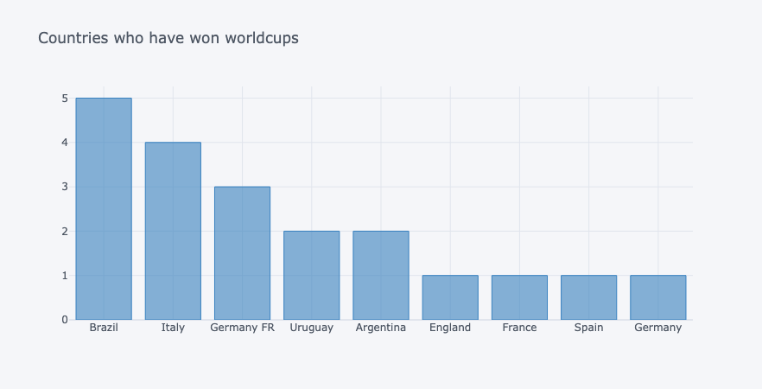
Fifa World Cup Analysis : EDA

Slide 14
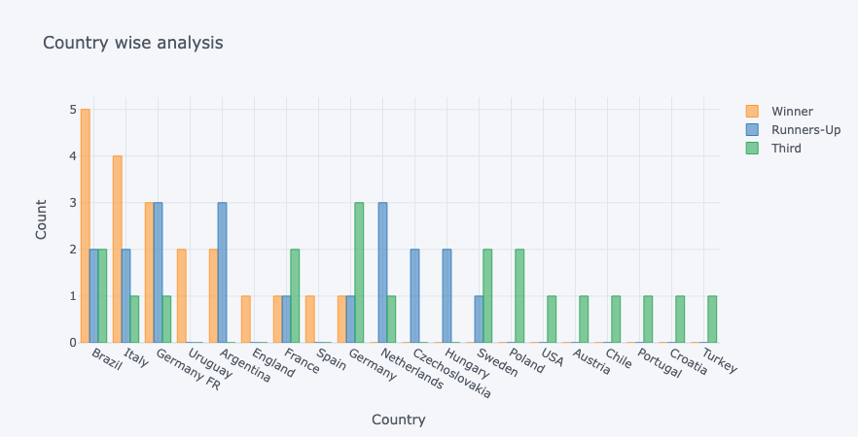
Fifa World Cup Analysis : EDA

Slide 15
Predictions and Insights for Future FIFA World Cup
Tactical Evolution: Insights into historical trends and winning strategies suggest a continued evolution in tactical approaches and playing styles. Future tournaments may witness innovative tactics, formations, and game strategies employed by top teams to gain a competitive edge on the global stage.
Global Football Diversity: As football continues to grow as a global sport, future World Cup tournaments are likely to showcase greater diversity in participating teams, playing styles, and fan engagement. Insights from historical data can help anticipate shifts in regional dominance, emerging football cultures, and fan demographics.
Host Country Influence: Analysis of host country advantages and historical trends in World Cup hosting suggests that host nations will continue to exert a significant influence on tournament outcomes. Insights into past host experiences can provide valuable predictions about the impact of hosting privileges, home advantage, and fan support on future tournaments.

Slide 16
Conclusion
The FIFA World Cup analysis has provided valuable insights into the rich history, trends, and dynamics of the world's most prestigious football tournament. Through comprehensive data exploration and analysis, we have uncovered significant patterns, insights, and predictions that offer valuable perspectives on the future of the tournament.
In conclusion, the FIFA World Cup analysis has provided valuable insights into the tournament's past, present, and future, offering a deeper understanding of its significance as a global sporting spectacle and cultural phenomenon.

